Slide 1
FINA 1303 THE SELL-SIDE: INVESTMENT BANKS
Veronique Lafon-Vinais
Associate Professor of Business Education - Department of Finance

Slide 2
Course Map
Overview
Foundations of
Interest Rates
Financial Institutions
Pricing of Financial Assets
Regulations
DCF
Sell Side
Buy Side
Stock
Valuation
Banking Regulation
Basics of
Interest Rates
Commercial Banking
Traditional Institutional Investors
Asset
Pricing
Models
Monetary Policy
Investment Banking
Alternative Investors
2

Slide 3
Course map
Overview
Financial Institutions
Sell Side
What are Investment Banks?
What do Investments Banks do?
Investment Banks vs. Commercial Banks
Investment Banking

Slide 4

Main Street v. Wall Street

Slide 5
Class Discussion
What is investment banking? What do Investment Banks do?

Slide 6
Disclaimer
This material is intended solely for information purposes and is not to be construed, under any circumstances, by implication or otherwise, as an offer to sell or a solicitation to buy or sell or trade in any commodities or securities herein named. Information is obtained from sources believed to be reliable, but is in no way guaranteed. No guarantee of any kind is implied or possible where projections of future conditions are attempted. In no event should the content of this material be construed as an express or implied promise, guarantee or implication that you will profit or that losses can or will be limited in any manner whatsoever. All investments are subject to risk, which should be considered prior to making any investment decisions.

Slide 7
Securities Firms & Investment Banks
Securities Industry
Corporate Finance:
Assisting firms in raising capital and providing advice about M&A, corporate restructuring and finance
Brokerage and market making:
Sale and trading of securities
Primary Market
Secondary Market
Investment banks
Securities Firms (Brokers and Dealers)
Notes:
Source: http://www.iii.org/financial2/securities/overview/
The securities industry consists of securities brokers and dealers, investment banks and advisers, and stock exchanges. Together, these entities facilitate the flow of funds from investors to companies and institutions seeking to finance expansions or other projects. Firms that make up the securities sector may specialize in one segment of the business or engage in a wide range of activities that includes brokerage, asset management and advisory services, as well as investment banking. As part of their asset management activities, some firms sell their own and others’ annuities.
Investment banking involves the underwriting of new debt securities (bonds) and equity securities (stocks) issued by private or government entities to finance new projects. Investment banks buy the new issues and, acting essentially as wholesalers, sell them, primarily to institutional investors such as banks, mutual funds and pension funds. Investment banks are sometimes referred to as securities dealers or broker/dealers because many also participate in the financial market as retailers, selling to individual investors. The primary difference between a broker and dealer is that dealers buy and sell securities for their own account, whereas brokers act as intermediaries for investors who wish to purchase or sell securities. Dealers make money by selling at a slightly higher price than they paid. Like underwriters and wholesalers, they face the risk that the securities in their inventory will drop in price before they can resell them.

Slide 8
Bank v. Investment Bank v. Investment Banking
Bank
Commercial Bank
Investment Bank
Private
Bank
Asset Management
Global Markets
Investment Banking
Support Functions
Sales & Trading (Equity; FICC; Derivatives)
Research
Corporate Finance
(Coverage; Execution)
M&A
ECM
DCM
Rating Advisory
Legal, Compliance, Credit Risk, Market Risk, Operations, Finance,….
Notes:
Bank (say UBS) = Investment Bank + Private Bank + Asset Management (often regrouped with Private Bank into Wealth Management)
Investment Bank = Global Markets + Investment Banking + Supporting functions (Legal, Compliance, Credit Risk, Market Risk, Operations, Finance,….)
Global Markets (outside the wall) = Trading and sales of equity, fixed income, commodities, derivatives of the above + research, equity and fixed income (inside the research information barrier)
Investment Banking (inside the wall) = Corporate finance coverage (Countries and Sectors), M&A, ECM (often a JV equity but inside the wall and PAID by Investment Banking), DCM (often a JV with Fixed Income but inside the wall and PAID by Investment Banking), Corporate Finance execution pool, Hybrids, Rating Advisory

Slide 9
Securities Brokers & Dealers
Securities Brokers
Securities Dealers
Full Service Brokers offer clients research and investment advice, but usually charge a higher commission on trades.
Discount Brokers provide facilities to buy/sell securities but offer no advice
Hold inventories of securities on their own account
Provide liquidity to the market by standing by ready to buy or sell securities (market maker)
Merrill Lynch is the largest full service brokerage house in the US
Charles Schwab is the best known discount broker
Source: Mishkin/Eakins
Notes:
Many on-line discount brokerage firms do have significant research available
The Securities Industry and Financial Markets Association (SIFMA) groups broker/dealers into four categories. The first and largest category, "major firms", consists of national full line companies, which are full service broker/dealers with an extensive national and international branch network system. This category also includes large investment banks and the largest U.S. broker/dealer subsidiaries of global financial holding companies. The major firms provide a broad array of financial services and products to households and institutions.
The second category is regional brokers. Operating on a somewhat smaller scale than the major firms, they offer a range of investment services based on their size and business specialty. Because of their regional expertise, these brokers participate in underwriting securities for businesses that are centered in their region.
New York City (NYC) area regionals, the third category, are mostly broker/dealer subsidiaries of U.S. and foreign banks and securities organizations, excluding those that fall into other listed categories, and are generally institutionally oriented. The fourth category is discounters, broker/dealers primarily engaged in the discount brokerage business.
Only a small percentage of the companies in these four categories are included in the "total firms" column of the chart below. "Total firms" consists of all New York Stock exchange broker/dealers doing public business. It is used by SIFMA as a proxy for the total industry as it accounts for approximately 60 to 80 percent of revenues, capital and assets of all brokers/dealers in the U.S.

Slide 10

Quick Quiz!
Corporate finance is:
Primary market
Secondary market
Full service brokers offer
Only brokerage service
Also offer advice
Which provides liquidity?
Broker
Dealer

Slide 11
Course map
Overview
Financial Institutions
Sell Side
What are Investment Banks?
Investment Banks vs. Commercial Banks
What do Investments Banks do?
Investment Banking

Slide 12
What is the difference between investment banks and commercial banks?
Merchant banks and investment banks
Origins of US investment banks
Basic frameworks for financial services organization

Slide 13






From Merchant to Investment Banks
Notes:
Barings Bank, previously known as Baring Brothers & Co., was the oldest merchant banking company in England, having been founded in 1762 by Sir Francis Baring.
Rothschild: Mayer Amschel Rothschild's role as Court Agent to the local Landgrave in the early years of the 19th century, watching and understanding the money markets, seeking out new investment opportunities.
Samuel Montagu was absorbed by Midland Bank and is now part of HSBC
SG Warburg & Co Limited founded in London in 1946 was absorbed by SBC in 1994, SBC later merged into UBS
Merchant bank = A bank that deals mostly in (but is not limited to) international finance, long-term loans for companies and underwriting. Merchant banks do not provide regular banking services to the general public. “Their knowledge in international finances make merchant banks specialists in dealing with multinational corporations.” (Source: Investopedia)
In banking, a merchant bank is a United Kingdom term for an Investment Bank. It is also used to describe the private equity activities of banking. This article is about the history of banking which originated with merchants, and has nothing to do with the use of the term today. Merchant banks, now so called, are in fact the original "banks". These were invented in the middle ages by Italian grain merchants. (Source: Wikipedia)

Slide 14
Investment Banks
Investment banks were essentially created in the U.S. by the passage of the Glass-Steagall Act (1933). Prior to this, investment banking activities were part of large, money-center commercial banks
The lines between investment banks and commercial banks again begins to blur as legal separation between investment banks and commercial banks is no longer required
Following the Citi-Travellers merger in 1998, the Gramm-Leach-Bliley Act (1999) effectively repealed Glass-Steagall
Source: Mishkin/Eakins

Slide 15







Investment vs. Commercial Banks: Is there a difference?

Slide 16
Basic framework for Banking & Securities
Global Banks
Universal banking
Financial Supermarket (FHCs and BHCs)
Legal separation
Banks can provide a full range of financial services (incl. insurance, securities, real estate) under same legal entity
Banks can provide a full range of financial services (incl. insurance, securities, real estate) but each different activity must be carried out under a different legal entity
Banks are prohibited from engaging in securities activities and other financial services such as insurance
Notes:
Spurred by the passage of the Gramm-Leach-Bliley Financial Services Modernization Act of 1999 (GLB), many leading financial services companies are now doing business across sectors. GLB permits banks, securities firms and insurance companies to affiliate with each other through the financial holding company (FHC) structure. FHCs can engage in activities other than banking as long as they are financial in nature. The most important of these are securities underwriting and dealing, insurance underwriting, insurance agency activities and merchant banking, a form of equity financing. The first step in electing FHC status is becoming a bank holding company (BHC), a company that owns one or more banks. BHCs must meet certain eligibility requirements in terms of capital, management and community investment to become an FHC. GLB allows existing BHCs that have opted for FHC status to acquire full service securities firms and insurance companies. It also permits insurers and securities firms to buy a bank and thus become a BHC eligible for FHC status. One example is Met Life, which purchased a bank and became a FHC. GLB also allowed banks owned by BHCs to expand into financial services activities by creating financial subsidiaries. Income from these subsidiaries’ activities flows up to the BHC parent, and is reported as income by the parent. But the activities permitted banks are not as broad as for FHCs. Financial subsidiaries of banks may not engage in insurance underwriting. In addition, they may not engage as a principal in providing or issuing annuities or in real estate development and investment, merchant banking or insurance investment activities. Before passage of GLB, BHCs could be involved in the securities business, but what they were permitted to do was strictly limited by law.

Slide 17
Current issue: Should Glass-Steagall be reinstated? Pros and cons of narrow banking
Pros
Cons
Protect depositors
Simplify regulation of depository institutions
More transparency for depository institutions customers
Lessens systemic risk
Restricts financial innovation
Limits profit opportunity and competition
Banks will find loopholes, just like in the past
Notes:
Source: http://www.businessweek.com/magazine/content/09_06/b4118030606341.htm?chan=magazine+channel_news, How Banking Diversification Steered Us Wrong by Amar Bhide

Slide 18
Summary (KLOs)
Differentiating securities firms & investment banks
Understanding corporate finance
Commercial banking v. investment banking
brokers and dealers
Regulation of investment banks:
Glass-Steagall Act
Gramm-Leach-Bliley Act
Basic framework
Narrow Banking

Slide 19
Test Your Understanding
Core investment banking activities such as corporate finance advisory and IPOs underwriting take place in the
Primary market
Secondary market
Which legislation gave birth to the first investment banks (e.g. Morgan Stanley)?
Gramm Leach Bliley Act
ERISA
Glass Steagall Act

Slide 20
Course map
Overview
Financial Institutions
Sell Side
What are Investment Banks?
Investment Banks vs. Commercial Banks
What do Investments Banks do?
Investment Banking

Slide 21
What do investment banks actually do?
Products and Services of investment banks
Actors in investment banks

Slide 22
Products and Services of Investment Banks
Advisory
Underwriting
Securities
(Debt & Equity)
Broker/Dealer
M&A
Origination
ECM
Selling
Capital Raising
Syndication
DCM
Trading

Slide 23
Trading: Client vs. Risk-driven revenues
Measuring client value remains more an art than a science
“Flow” trading => Client-driven revenues = fees and commissions, markups and spreads as measured through sales and production credits
“Prop” trading => Risk-driven revenues = dedicated proprietary trading that is delinked from customer business, and substantial residual revenue between sales and production credits
For most players, capital markets are primarily a client business, not a proprietary trading business => client franchise building and delivery are critical
The “Volcker rule” (part of Dodd-Franck Act) prohibits “prop” trading in banks in the US but is in the process of being repelled
Notes:
Some banks are undoubtedly shifting a portion of their risk taking and revenue outside of capital markets to areas such as proprietary investments. Moreover, measuring client value remains more an art than a science, with many institutions seeking to improve the consistency of their methodology. But neither of these factors begin to explain the dominance of client revenues. For most players, it would seem, capital markets are primarily a client business, not a proprietary trading shop. Client franchise building and delivery should be a central strategic imperative for any leader in capital markets. Although client volumes and risk performance are both inherently volatile, a deeper question arises as to whether capital markets activities actually generate revenue streams that are more stable than usually assumed. Indeed, if the implied downside of risk revenues is not as great as everyone thinks, do capital markets not merit higher P/E multiples than the market is currently awarding them?

Slide 24

Chinese Walls & Information Barriers
Everybody Else
Corporate Finance
M&A
Bankers
Notes:
Chinese Walls are a key ingredient of investment banking. They apply whether the entity is an “investment bank” or a “commercial banks” as long as it carries out investment banking activities such as M&A and equity IPOs. In market parlance, being “inside the wall” means having access to priviledged information which could be used for “insider dealing”. Many rules and compliance policies deal with this aspect of the job, including more recent rules governing the separation of research and investment banking post –Spitzer settlements.

Slide 25
Chinese Walls & Information Barriers
Client
Trading
Corporate
Finance
Execution
Group
Sales
Bankers
ECM
Derivatives
Client
Derivatives
Risk
Management
M&A
Client
DCM
Credit
Research
Notes:
Corporate Finance generally performs 2 different functions: M&A advisory and underwriting I.e. shepherding the process of raising capital for the company.
Purple is the product specialists such as ECM, DCM and Derivatives.
Blue is the support groups: Research, Credit, Risk Management and Corporate Finance Execution.
Red circle represents the investment banking or corporate finance group. It includes bankers, corporate finance and M&A, ECM and DCM (origination and syndication) and derivatives structurers who work on specific deals. M&A has a specific sub-Wall with more restrictive rules than corporate finance, they operate strictly on a need-to-know basis. Credit and research have their own Chinese walls to prevent info being leaked prior to publication.
For a particular client, a “Client Service Team” will typically be assembled, including the banker, CFE personnel and relevant product specialists
Red circles and red lines represent Chinese Walls.

Slide 26
Investment banks in Asia: recent trends, issues, implications?
Group 8
Video link
https://www.youtube.com/watch?v=dThut_z5LOY
Article link
https://www.bloomberg.com/news/articles/2021-02-24/credit-suisse-ubs-move-bankers-to-mainland-china-from-hong-kong

Slide 27
Test Your Understanding
Financial institutions like Schwab which simply execute clients orders are an example of:
Full service brokers
Discount brokers
Investment banking boutiques
What is the purpose of Chinese Walls?
Preventing insider trading
Preventing leakage of price sensitive information
Both of the above
None of the above

Slide 28
Summary (KLOs)
Understanding the core services of IBs
Flow trading vs. Prop trading
information barriers (Chinese Wall) - purpose

Slide 29
Actors in I-Banks
Relationship Banker
Product Specialists
Corporate Finance & IB
Sales
Trading
Other Key Players : Research, Credit, Risk Management, ALCO

Slide 30
Relationship Banker
Client
Research
Product
Specialist
Banker
Client
Product
Specialist
Client
Product
Specialist
Credit
Notes:
Simplified version of interaction between banker and others.
Bankers will generally report to head of investment banking/corporate finance (in IB) or head of corporate banking (CB) which is generally a geographical role, and may have a dotted line to global head of IB or corporate banking.
Reporting lines may be more complex if bank arranged in industry groups.
Typically some of the functions will be in different geographical locations, necessitating cross-time lines coordination (e.g. US banks).
There will typically be regional banking teams and industry banking teams.
In ML, the banker draws on resources form corporate finance execution which is a big component of corporate finance.
The banker should prove to the customer that:
He understands the customer’s business very well (big picture)
He is very pro-active
He is available at any time

Slide 31
Product Specialists
Banker
Research
Sales team
Product
Specialist
Traders
Banker
Risk
Management
Banker
Market
Clients
Credit
Notes:
All the lines in the diagram above are not applicable to all product specialists, for example M&A specialists won’t deal with sales teams or traders.
Product specialists typically have multi-reporting lines: locally to country head and globally to product head. It can be further complicated depending on organizational structure.
Product specialists may also have portfolios of “single product” clients i.e. customers that only buy one type of product from the bank and therefore don’t need a relationship banker assigned to them.

Slide 32
Product Specialists
Investment Banks:
Commercial Banks
M&A
Equity Capital Markets
Debt Capital Markets
Securitization (ABS, MBS)
Derivatives
FX and MM
Syndicated Loans & Asset Sales
Project & Structured Finance
Debt Capital Markets
Securitization (ABS, MBS)
Derivatives
FX and MM
Syndicated Loans & Asset Sales
Project & Structured Finance
Cash Management
Trade Finance
Notes:
Information sources needs will vary according to the product specialisation.
We focus on the needs of originators, but ECM and DCM include originators and syndication; in investment banks, the traders and sales teams are separate and are not considered product specialists as such. Traders and sales are “outside the wall” for Chinese wall purposes.

Slide 33
Deal dynamics
BUY SIDE
SELL SIDE
Issuers
Bankers
Product specialists
Sales
Investors

Slide 34
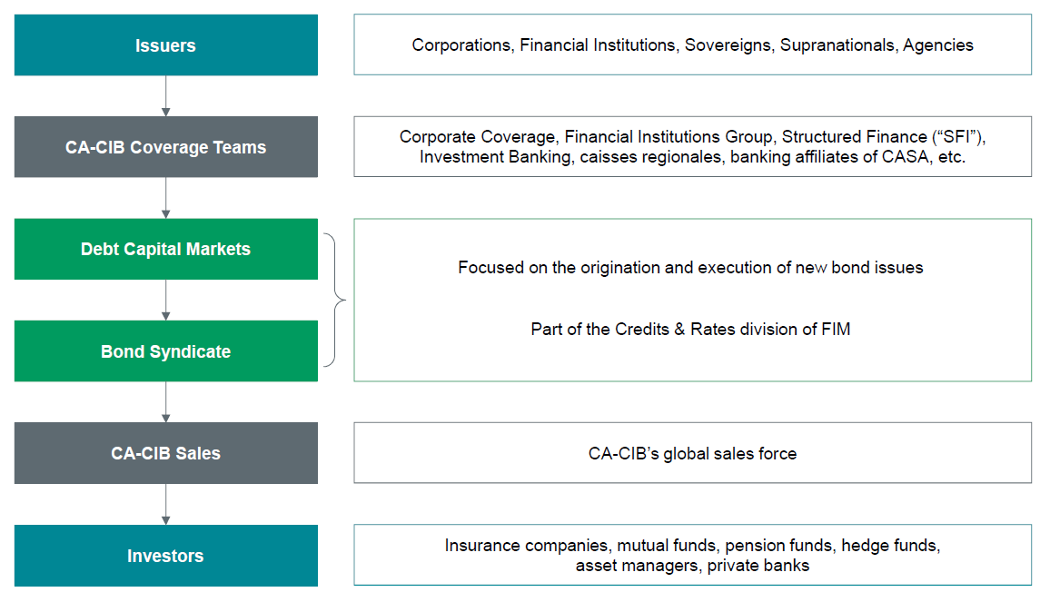
Deal dynamics at CA-CIB
Source: CA-CIB – Ben Lamberg

Slide 35
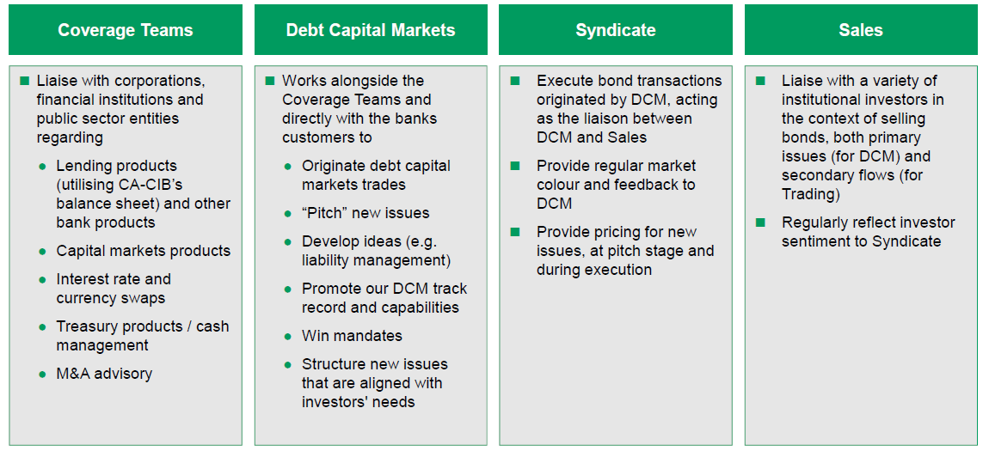
The role of actors in deal development
“Bankers”
“Origination”
“Underwriting”
“Sales”
Source: CA-CIB – Ben Lamberg

Slide 36
Corporate Finance Execution (CFE)
CFE Head
Geographical Team A
1 Director
1-2 VP
Associates
Analysts
Geographical Team B
1 Director
1-2 VP
Associates
Analysts
Geographical Team C
1 Director
1-2 VP
Associates
Analysts
Notes:
What do they do? Provide support to the bankers and product specialists in:
Preparing pitch books (includes gathering info from all parties, translation, presentation, printing, dispatching)
Crunching numbers (financial analysis, pro-forma forecasting, pro-forma valuation, C/F forecasting, sensitivity analysis, etc…)
Following up with product specialist on behalf of banker
Organization of roadshows (includes carrying suitcases!)
Taking notes in meetings and preparing call reports
Preparing weekly information reports for super-core or core clients (e.g., every week compiling a report to be sent by banker to client summarizing any news that may be of interest to client, for example, M&A deal in same industry in other geographical area)
The CFE head allocates resources according to urgency and client priority: e.g. if a banker needs something done for a super-core account, its top priority.
Teams are geographically allocated and situated: e.g. Team A maybe South-East Asian clients and based in Singapore, team B HK and Taiwan based in HK, Team C Mainland China and based in Shanghai, Team D Korea and based in Korea….
Typical organization is highly hierarchical, very structured:
the “grunts” are the analysts, typically BA educated, fresh from university; they spend between 1 and 4 years as analysts before heading back to get an MBA. Essentially they do all the work, have no private life and are paid a pittance compared to higher ranks. They get a base salary, minimum benefits and a bonus which is a function of peer review assessment, hierarchy assessment, and department pool. Main motivation is survive and perform well enough to climb the ranks.
Associates and above are typically MBAs; they will supervise a pool of analysts according to a strict hierarchical structure. For example, the executive summary in the pitchbook is drafted by the analysts, reviewed by each step of the hierarchy in expanding circles until ready to be sent to the banker and/or product specialist. It would be inconceivable for a banker to go to an analyst directly without going through the hierarchy.
Associates and above have a base salary and benefits according to title and experience, and a bonus based on peer review assessment, hierarchy assessment, and department pool.
Main motivation is to move up the ranks to the coveted position of relationship banker or product specialist (generally M&A).
The “grunts” get no recognition and no status; some of the higher ranked CFE executives might get recognition but rarely do they get status.

Slide 37
From the website of one investment bank, describing their analyst program:
In most divisions during this time you can expect:
A period of induction and initial training
Individual rotations in most functional areas
Exposure to senior management both on the floor and at social functions
An opportunity to network amongst your peers at numerous cross-divisional events throughout the summer
Small participant numbers ensure individual attention, a degree of flexibility to meet the individual's interests and strengths and mentoring throughout the Program

Slide 38
A Day In The “Life” Of A CFE Analyst…

Slide 39
A Day In The “Life” Of A CFE Analyst…

Slide 40
Number Crunching
Credit/Financial Analysis & the use of financial ratios
Forecasting cash flows, pro-forma financial statements & financial modeling
Capital budgeting & project evaluation
Market valuation
CAPM

Slide 41
Pitch Books
Deal structure & pricing
Rationale for the deal
Deal structure
Pricing information
Impact of deal on company’s financial structure
Proposed placement strategy & market impact
Consensus of analysts
Shareholder analysis
Comps:
Industry comparisons
Financial ratios
Market cap and stock prices
Industry reports
Deal comparisons
Pricing
After issue performance
League Tables
Other relevant bank info (market share, analyst ranking & publications,…)
Executive Summary!
=>Why iBank Is The Most Suited To Deliver Your Landmark Transaction?
Just Give Us The Mandate, and please, NO Co-Lead!

Slide 42
League Tables
For marketing purposes
For internal purposes
For performance evaluation

Slide 43
Sales
Client
Research
Client
Sales
Traders
Client
Client
Client

Slide 44
Trading
Product
Specialists
Market
counterparties
Traders
Risk
Management
Sales
Credit

Slide 45
Research
Client
Media
Research
Client
Information
Providers
Client
CFE
Industry
Sources
Client

Slide 46
Other Players
The hidden players
Corporate finance execution
Credit & Risk Management
Research (Credit & Equity)
Risk management
Others (e.g. systems)
What do they do?
Who are they?
What makes them tick?

Slide 47
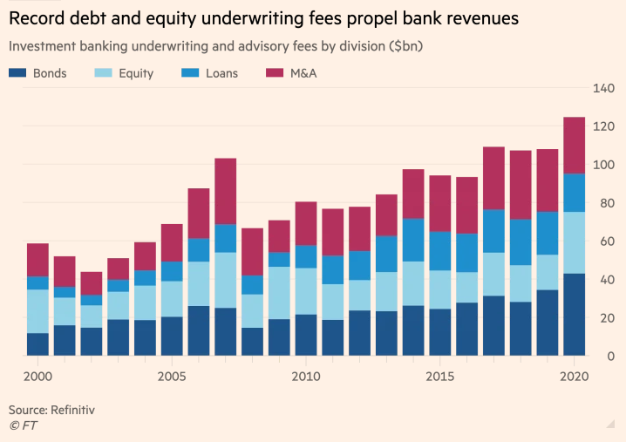
Investment Banking Fees (2000-2020)
Notes:
Source: FT 28 Dec 2020 https://www.ft.com/content/c7bbdc4e-2fc9-424b-ab0b-a3acd8f20557?segmentId=114a04fe-353d-37db-f705-204c9a0a157b

Slide 48
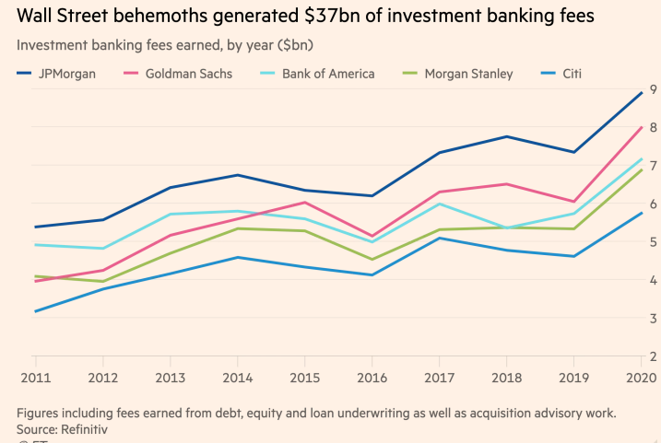
Investment Banking Fees (2011-2020)

Slide 49
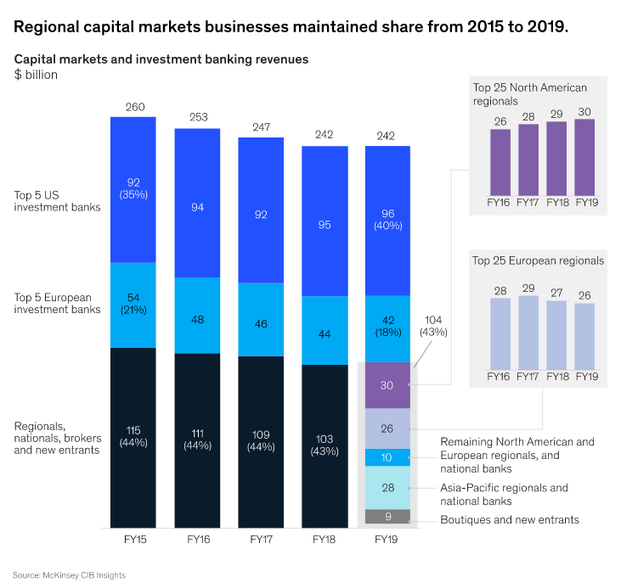
Regional capital markets businesses
Source: McKinsey Nov 2020
Notes:
Source: McKinsey Nov 2020 https://www.mckinsey.com/industries/financial-services/our-insights/tackling-the-performance-challenge-in-regional-capital-markets-businesses

Slide 50
The rise of electronic trading: will human traders disappear?
Group 9
Video link
https://www.youtube.com/watch?v=OqJySkJ_Erw
Article link
https://becominghuman.ai/can-the-ai-trader-beat-the-human-trader-afabce77e933

Slide 51
Summary (KLOs)
Understanding the actors in IB:
relationship banker
product specialist
Analysts (pitch book, league tables…)
Support functions
Understand deal dynamics
From the sell side to the buy side
role of actors in deal development

